Slide 1
Communications Plan:
Ji Young Kim, Chul Han Song,
Saewung Kim, and Jim Crawford

Slide 2
KORUS-AQ and MAPS-Seoul
Regardless how you see it, effective communication will maximize the scientific outcomes!
KORUS-AQ
MAPS-Seoul
KORUS-AQ
MAPS-Seoul

Slide 3
Science Team Communication by email
Need at least two mailing lists: 1) Full KORUS-AQ science team, 2) KORUS-AQ Leadership Team
Administration and privileges for sending messages to these lists needs to be discussed.
The full mailing list will be used for all official messages, announcements, etc.
The leadership list will be more limited and useful for discussing issues and decisions not requiring full science team input.

Slide 4
Science Team Communication by webex
Webex will be used to support leadership telecons (a leader(s) for each platform in advance of the campaign.
During the campaign, the science team will be distributed across many locations (Osan Air Base and numerous ground sites), therefore daily flight planning meetings and periodic science team meetings should also be supported by webex.
A separate phone line will be needed, but toll free call-in numbers can be provided.
Webex also allows directors, managers, and other remote staff to observe and participate in campaign meetings.

Slide 5
Science Team Communication by RSS feed
We should consider using an RSS feed during the campaign to support daily announcements such as upcoming flights and schedules for scientists. These messages could be received as text messages and would post automatically to the website.
Only a few key personnel would have privileges for posting to the RSS feed.
We will need a lead person(s) at each site

Slide 6
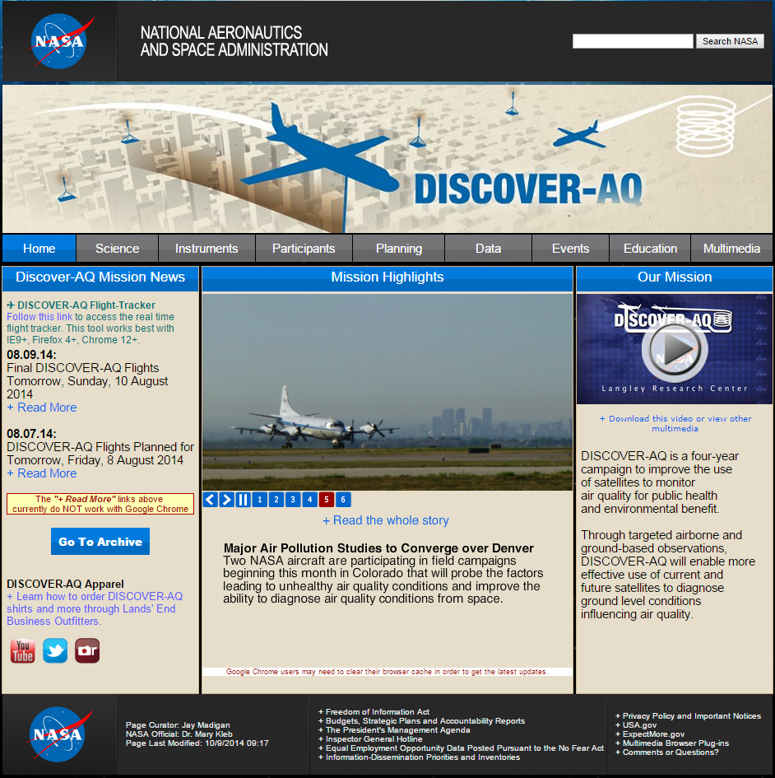
Science Team Communication by RSS feed
Email messages to the RSS feed automatically post to the website (example shown from DISCOVER-AQ)

Slide 7
Science Team Communication during Flight Operations
The DC-8 is capable of supporting active chat sessions with the ground during flights. The chat server is supported by NCAR and can be freely used by the community.
Active flight tracking is also available to monitor the DC-8 location in real time, allowing ground personnel to actively monitor and advise the DC-8 flight scientist. This is especially useful when coordinating ground activities with overflight by the aircraft.
Will in-flight communication and real-time location tracking be possible for the other aircraft?

Slide 8
Communication between Aircraft
If there is ever a plan to coordinate between the aircraft, it will be desirable to have the pilots communicate directly. Pilots should meet at the beginning of the campaign to make appropriate plans for radio communication when necessary.
Will translation be an issue?
Will all the participating aircraft be based at Osan Airfield? (KMA King Air)

Slide 9
Communication among the Platforms
The fast turnaround of interesting findings on the ground site will be essential for flight planning
Daily report from the ground site needs to highlight the main findings

Slide 10
Use of Social Media
Is there any desire to have a Facebook page or Twitter account for the science team?
Twitter could be another effective way to announce daily flight decisions and schedules for the next day.

Slide 11
Science Team Communication through the KORUS-AQ website
The website should be updated regularly during the field study to provide information important to the execution of field operations and assessment of progress in accomplishing objectives.
Daily announcements could be posted directly to the website or through RSS feed (see earlier slide on this)
Reports should be posted online regularly. These would include a daily forecast summary, flight plans, flight reports, daily instrument status reports, quicklook images, etc.

Slide 12
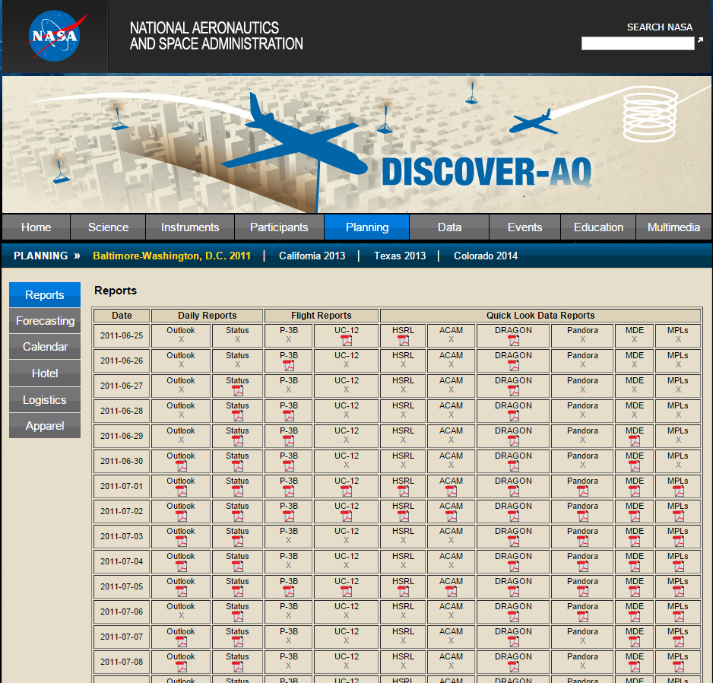
Science Team Communication through the KORUS-AQ website
Reports and quicklook data can be directly uploaded to the website as pdf files. (example shown from DISCOVER-AQ)

