Slide 1

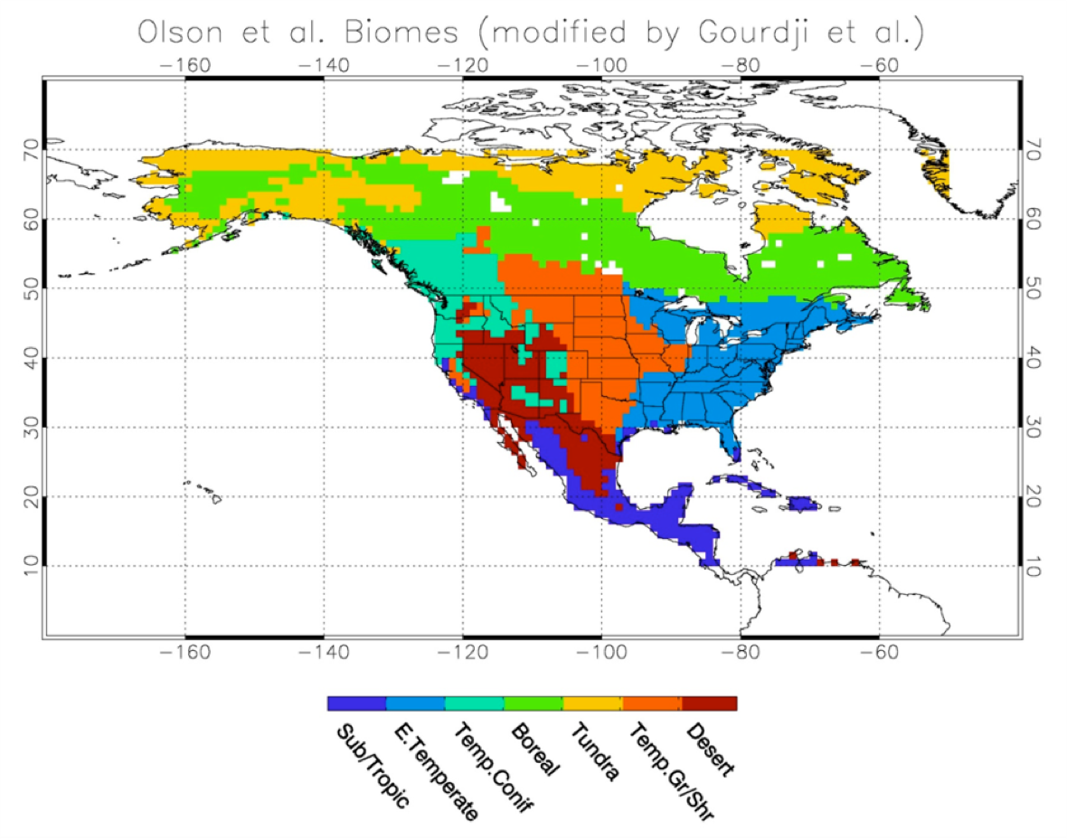
An Airborne System for Direct Validation of Regional Carbon Flux Estimates
S. Randy Kawa, Tom Hanisco, Paul Newman, Glenn Wolfe
NASA Goddard Space Flight Center
Objectives
Assemble a versatile, economical system for measuring airborne fluxes
Quantify greenhouse gas (GHG) sources/sinks over a spectrum of ecosystems
Evaluate biophysical process models and parameterizations
Validate top-level satellite flux products from OCO-2 and other missions
The C-23 Sherpa is an ideal platform for airborne flux observations.
Physical: ample payload capacity (3.5 ton), nose amenable to 3D wind sensors
Flight envelope: low (200’), slow (110 kts), good duration (6 h)
Cost: ~$1000 per flight hour
Airborne GHG fluxes can address a suite of global questions.
  How does land-air exchange of CO₂ and CH₄ respond to climate-induced stresses (heat, drought, pests)?
  How do energy production (oil/gas, corn ethanol) and agricultural activities impact GHG inventories?
  What is the release rate of CH₄ from thawing permafrost?
Why fluxes?
Earth system processes (e.g. emissions, deposition) are typically quantified indirectly through top-down or bottom-up inventories, which are highly uncertain and/or of limited representativeness
Airborne eddy covariance fluxes provide a direct measurement of surface-atmosphere exchange at ecosystem-relevant scales of 1 – 100 km
The Sherpa flux platform can be adapted to other science objectives as well, such as biogenic emissions, nitrogen and ozone deposition, and atmospheric chemistry
For more information, contact:
S. Randolph Kawa, NASA Goddard Space Flight Center, Code 614
tel. 301/614-6004, stephan.r.kawa@nasa.gov
17 Dec 2015

